Slide 1

SECD2523 DATABASE
TOPIC 5
ENHANCED ENTITY RELATIONSHIP MODELLING
Content adapted from Connolly, T., Begg, C., 2015. Database Systems: A Practical Approach to Design, Implementation, and Management, Global Edition. Pearson Education.

Slide 2
LECTURE LEARNING OUTCOME
By the end of this lecture, students should be able to:
01
Define basic concepts associated with EER diagram
02
Produce EER model to represent information to application system

Slide 3
Introduction
Limitations of basic concepts of the ER model and requirements to represent more complex applications using additional data modeling concepts.
Most useful additional data modeling concept of Enhanced ER (EER) model is called specialization/generalization.
A diagrammatic technique for displaying specialization/generalization in an EER diagram using UML.

Slide 4
Enhanced Entity-Relationship Model
  To respond to increase requirements of more complex applications
  Basic concepts of ER modeling are not sufficient to represent requirements of newer, more complex applications.
  Response is development of additional ‘semantic’ modeling concepts.
  Semantic concepts are incorporated into the original ER model and called the Enhanced Entity-Relationship (EER) model.
  Examples of additional concept of EER model is called specialization / generalization.

Slide 5
Specialization / Generalization
Superclass
  An entity type that includes one or more distinct subgroupings of its occurrences, which must be represented in a data model.
Subclass
  A distinct subgrouping of occurrences of an entity type, which must be represented in a data model.

Slide 6
Specialization / Generalization
Superclass-subclass relationship is one-to-one (1:1).
Superclass may contain overlapping or distinct subclasses.
Not all members of a superclass need be a member of a subclass.

Slide 7
Specialization / Generalization
Attribute Inheritance
  An entity in a subclass represents same ‘real world’ object as in superclass, and may possess subclass-specific attributes, as well as those associated with the superclass.
Specialization
  Process of maximizing differences between members of an entity by identifying their distinguishing characteristics.
Generalization
  Process of minimizing differences between entities by identifying their common characteristics.

Slide 8
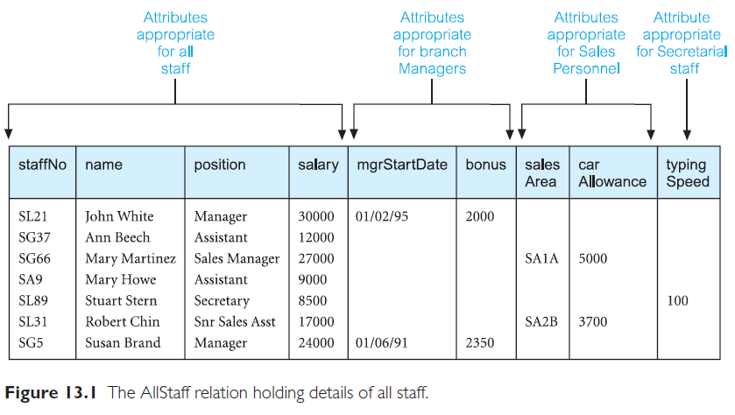
Example: AllStaff relation holding details of all staff

Slide 9
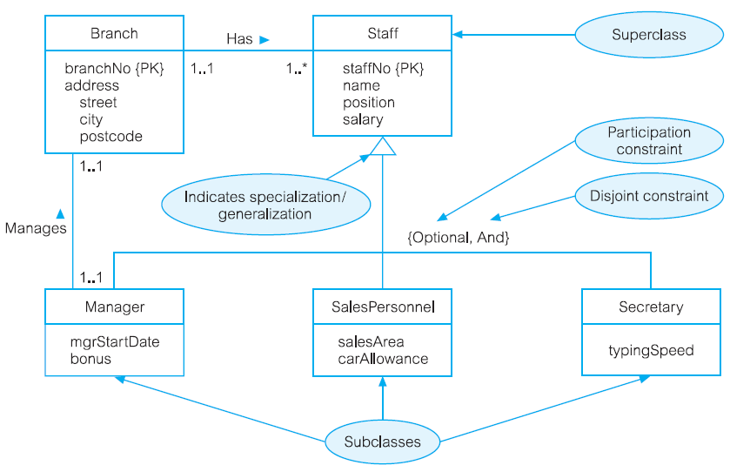
Specialization/generalization of Staff into subclasses representing job roles

Slide 10
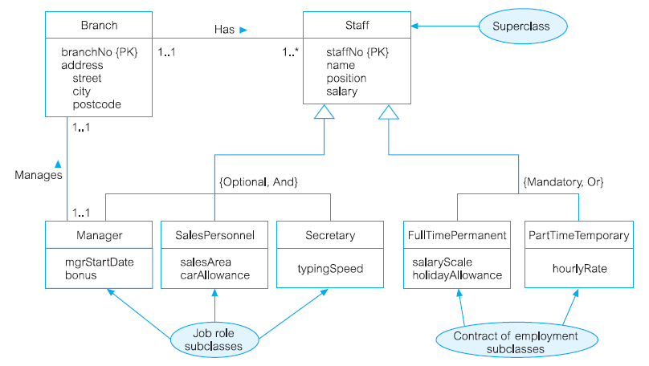
Specialization/generalization of Staff into job roles and contracts of employment

Slide 11
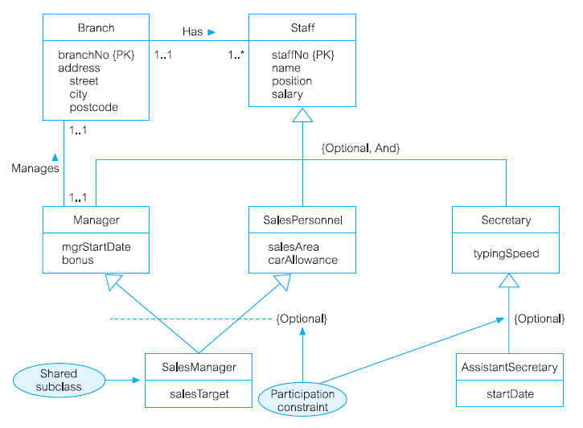
EER diagram with shared subclass and subclass with its own subclass

Slide 12
Constraints on Specialization/Generalization
Two constraints that may apply to a specialization/ generalization:
  participation constraints
  disjoint constraints.
Participation constraint
  Determines whether every member in superclass must participate as a member of a subclass.
  May be mandatory or optional.
  Mandatory: Every member of superclass must be a member of a subclass
  Optional: Every member of superclass need not belong to any of its subclasses

Slide 13
Constraints on Specialization/Generalization
Disjoint constraint
  Describes relationship between members of the subclasses and indicates whether member of a superclass can be a member of one, or more than one, subclass.
  May be disjoint (OR) or non-disjoint (AND)
  Disjoint: An entity occurrence can be a member of only one of the subclass
  Non-disjoint: An entity occurrence can be a member of more than a subclass

Slide 14
Constraints on Specialization/Generalization
There are four categories of constraints of specialization and generalization:
  mandatory and disjoint {mandatory, or}
    E.g.: Any member of staff must be attached to a department, but it is possible for a department to have no staff allocated.
  optional and disjoint {optional, or}
    E.g.: A member of staff does not have to be placed in a department, but all departments must have at least one member of staff.

Slide 15
Constraints on Specialization/Generalization
There are four categories of constraints of specialization and generalization:
  mandatory and non-disjoint {mandatory, and}
    E.g.: A member of staff must be assigned to a given department, and any department must have staff. There can be no unassigned staff, and it is not possible to have an 'empty' department
  optional and non-disjoint {optional, and}
    E.g.: A member of staff might be assigned to work in a department, but this is not compulsory. A department might, or might not, have staff allocated to work within it

Slide 16
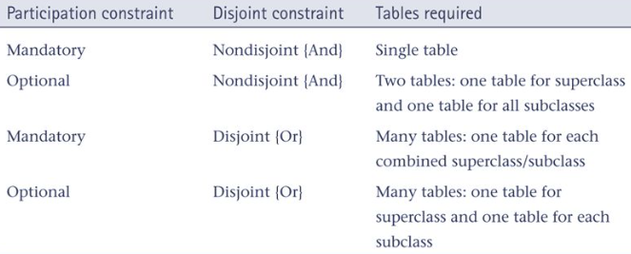
Constraints on Specialization/Generalization

Slide 17
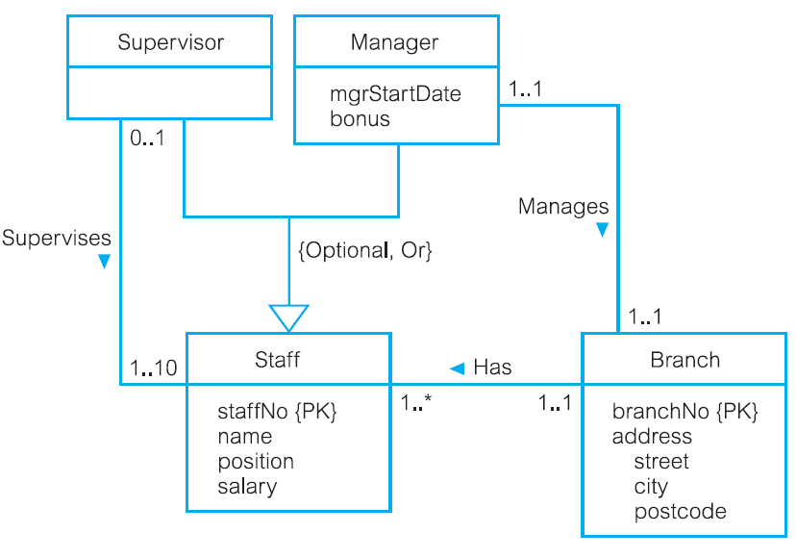
DreamHome example - Staff Superclass with Supervisor and Manager subclasses

Slide 18
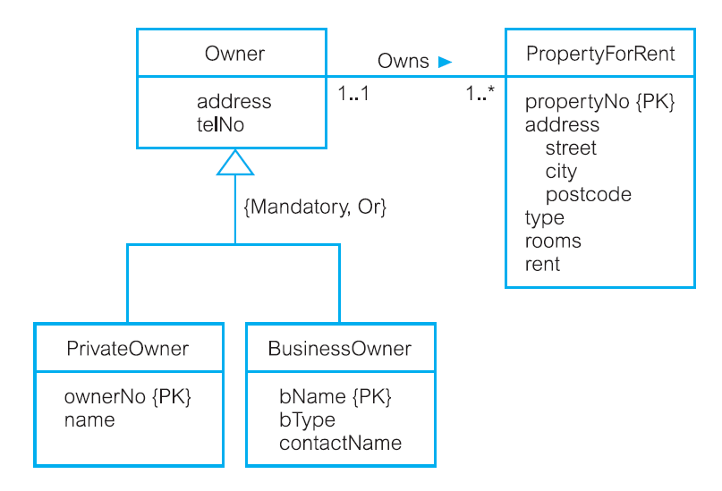
DreamHome example - Owner Superclass with PrivateOwner and BusinessOwner subclasses

Slide 19
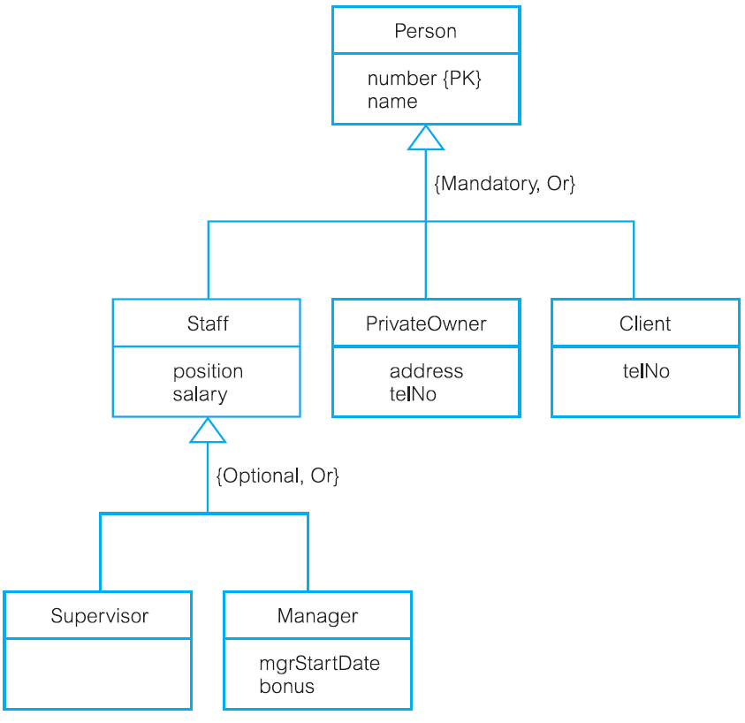
DreamHome example - Person superclass with Staff, PrivateOwner, and Client subclasses

Slide 20
Problem 1: EERM
A car dealership wishes to maintain data about the customers who purchase a car. Each customer may purchase one or more vehicles and each vehicle can be purchased by many different customers over time (for example, a customer may purchase a new vehicle, trade that vehicle in and someone else can purchase the vehicle traded in.) Data that the dealership wishes to keep regarding customers includes customer identification number, name, address, home phone, work phone, cell phone and e-mail address.
Information about vehicle includes vehicle identification number, make, model, year, transmission type, engine size and color. Vehicles can be a member of one of the following categories: cars, trucks, minivans or SUVS. A vehicle can be a member of only one category at a given time. Trucks, minivans and SUVS have unique attributes – cars does not. Trucks have the following unique attributes: Cab (example: regular, super or crew) and Driver (for example: 94X2 or (4X4); Minivans have Accessory package and SUVS have SUV style.
The dealership is interested in the date of Purchase, amount of sale and Salesperson(s) completing each sale.

Slide 21


